Slide 1

Green QR: Smart Tree Information System
by
A. Chaithanya
Roll No. 224G1A0513
B. Shantha Vardhan
Roll No. 224G1A0597
V. Likith Kumar
Roll No. 224G1A0542
Under the guidance of
Dr. P. Veera Prakash, M.Tech., Ph.D
Assistant Professor
Department of Computer Science and Engineering
Srinivasa Ramanujan Institute of Technology
Autonomous
Rotarypuram Village, B K Samudram Mandal, Ananthapuramu – 515701.
2025-2026
A - 15
Department of Computer Science and Engineering
Srinivasa Ramanujan Institute of Technology
01

Slide 2
Comments
Green QR: Smart Information System
What problem does the GreenQR Smart Tree Information System aim to solve?
How can the system be expanded to manage a large number of trees in different locations?
What improvements can be added in the future to make the GreenQR Smart Tree Information System more efficient?
Srinivasa Ramanujan Institute of Technology

Slide 3
Title Justification
Green QR: Smart Information System
The title “Green QR: Smart Tree Information System” reflects the core idea of the project using QR codes to provide verified, structured, and app-secured information about every tree.
It highlights:
Green → Represents trees, environment, sustainability.
QR → Technology used to uniquely identify each tree.
Smart Information System → Indicates the digital, secure, app-based data retrieval method.
Srinivasa Ramanujan Institute of Technology

Slide 4
Contents
Green QR: Smart Tree Information System
Abstract
Introduction
Literature survey
Existing System
Proposed System
Planning
Design
Implementation
Research Paper
References
GitHub Link
Srinivasa Ramanujan Institute of Technology

Slide 5
Abstract
Green QR: Smart Tree Information System
The Green QR Smart Tree Information System raises environmental awareness by providing digital details of campus trees via QR codes.
It replaces traditional, non-standardised tree management with a real-time, interactive system for monitoring and public access.
Each tree is assigned a unique QR code linked to a central database with species, location, oxygen output, medicinal uses, and other details.
Administrators can efficiently add, manage, and track trees, while users quickly scan QR codes for verified information.
The system promotes transparency, engagement, and campus sustainability by making tree data easily accessible on mobile devices.
Srinivasa Ramanujan Institute of Technology

Slide 6
Introduction
Green QR: Smart Tree Information System
GreenQR is a smart digital platform designed to bridge the gap between technology and nature by creating a "Digital Identity" for campus trees.
The system replaces traditional, static tree nameplates with an interactive QR-code-based interface that provides instant access to botanical data.
An integrated Admin Dashboard allows for centralized management, enabling authorities to add, update, and track tree records in real-time.
Each tree is meticulously documented with its scientific name, medicinal properties, and estimated oxygen contribution to promote environmental awareness.
With features like searchable databases and tree health monitoring, the system ensures transparency and efficient campus biodiversity management.
Ultimately, this project fosters sustainability by making complex environmental data easily accessible to students and visitors through their smartphones.
Srinivasa Ramanujan Institute of Technology

Slide 7
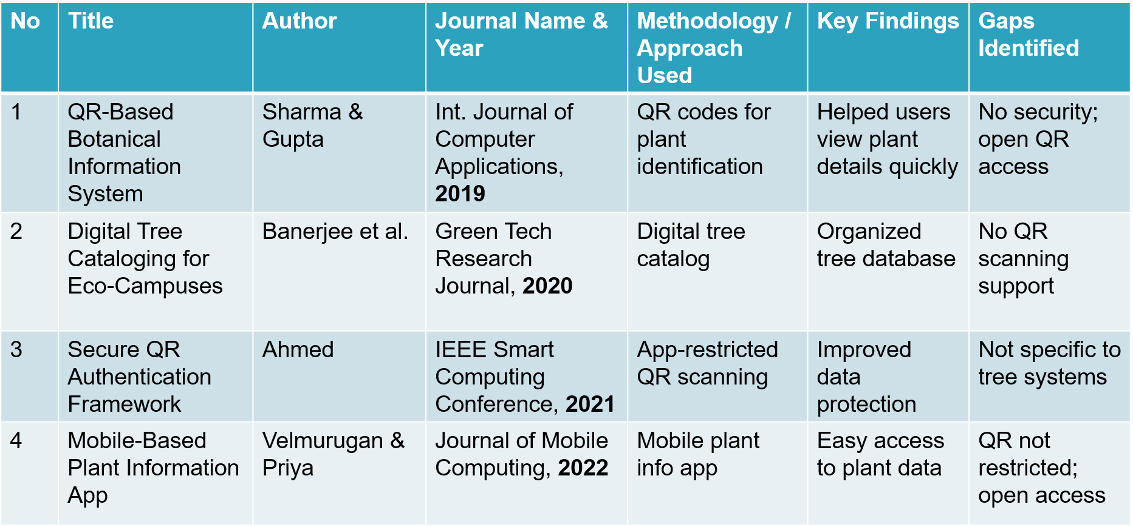
Literature survey
Green QR: Smart Tree Information System
Srinivasa Ramanujan Institute of Technology

Slide 8
Exisiting System
Green QR: Smart Tree Information System
Tree records are managed through manual paper registers or basic spreadsheets, leading to disorganized data and slow retrieval.
Identification relies on static physical nameplates, which offer very limited information and no interactive features for students.
Traditional signage suffers from physical degradation like rusting, fading, and weathering, requiring high maintenance costs.
Detailed information on medicinal uses and oxygen contribution is not accessible on-site and requires manual research in textbooks.
There is no centralized monitoring system to track tree health or total counts, making campus biodiversity management inefficient.
Srinivasa Ramanujan Institute of Technology

Slide 9
Proposed System
Green QR: Smart Tree Information System
The system utilises a Firebase Cloud backend to provide admins with a real-time dashboard for managing tree records and oxygen contribution data.
By digitising botanical information, the platform promotes environmental awareness and ensures efficient, transparent management of campus biodiversity for all users.
Module 1: Admin Dashboard (Android Studio – Java/Kotlin)
Purpose:
To manage the campus botanical database and monitor tree health in real-time
Features:
Email-based login for admin access using Firebase Authentication.
Tools to add, edit, and delete tree records like scientific names and locations.
A live "Total Trees" counter that updates automatically as the database changes.
Srinivasa Ramanujan Institute of Technology

Slide 10
Proposed System cont…
Green QR: Smart Tree Information System
Module 2: Mobile Application & QR Interface (Android Studio – Java/Kotlin)
Purpose:
To provide a user-friendly interface for students and visitors to interact with nature. Features:
Unique QR IDs linked to specific digital tree profiles for instant mapping.
Direct access to medicinal uses, oxygen levels, and physical height data.
Search functionality to find trees by name, ID, or location, like "C Block Front.“
Module 3: Cloud Backend & Data Management (Firebase)
Purpose:
To ensure secure data storage and instant synchronization across devices. Features:
Real-time database for storing tree IDs, botanical data, and timestamps.
Cloud storage for hosting high-quality tree photos in the "All Trees" section
Secure sign-in protocols and role-based access control for administrators.
Srinivasa Ramanujan Institute of Technology

Slide 11
Proposed System cont…
Green QR: Smart Tree Information System
Module 4: Testing and Quality Assurance
Unit Testing: Individual components (UI, Java/Kotlin classes, Firebase triggers) are tested for functionality.
System Testing: The integrated system undergoes testing to ensure smooth interaction between the App and Cloud.
QR Validation: Verifies that each unique ID correctly maps to its specific tree profile in the database.
Module 5: Deployment
Android Deployment: The application is built as an APK for easy campus-wide installation.
Cloud Deployment: The backend (Firebase) is deployed on cloud servers for high scalability and availability.
Srinivasa Ramanujan Institute of Technology

Slide 12
Planning
Green QR: Smart Tree Information System
Functional Requirements
Secure login for administrators using Firebase to manage tree records and system settings.
Tools to add and delete tree records like scientific names, locations, and oxygen levels.
Built-in scanner to instantly fetch and display digital tree profiles from the cloud database.
Non-Functional Requirements
Performance
Reliability
Security
Scalability
Usability
Srinivasa Ramanujan Institute of Technology

Slide 13
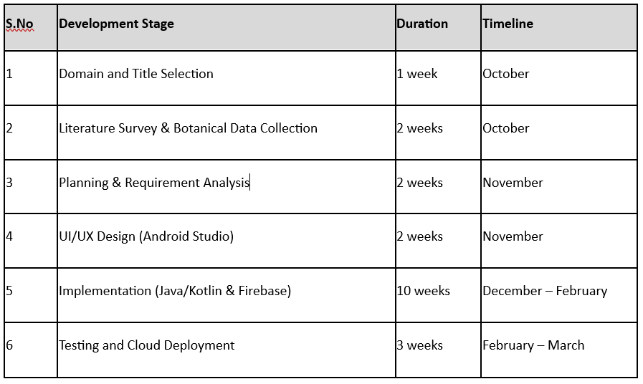
Planning – Development Stage
Green QR: Smart Tree Information System
Srinivasa Ramanujan Institute of Technology

Slide 14
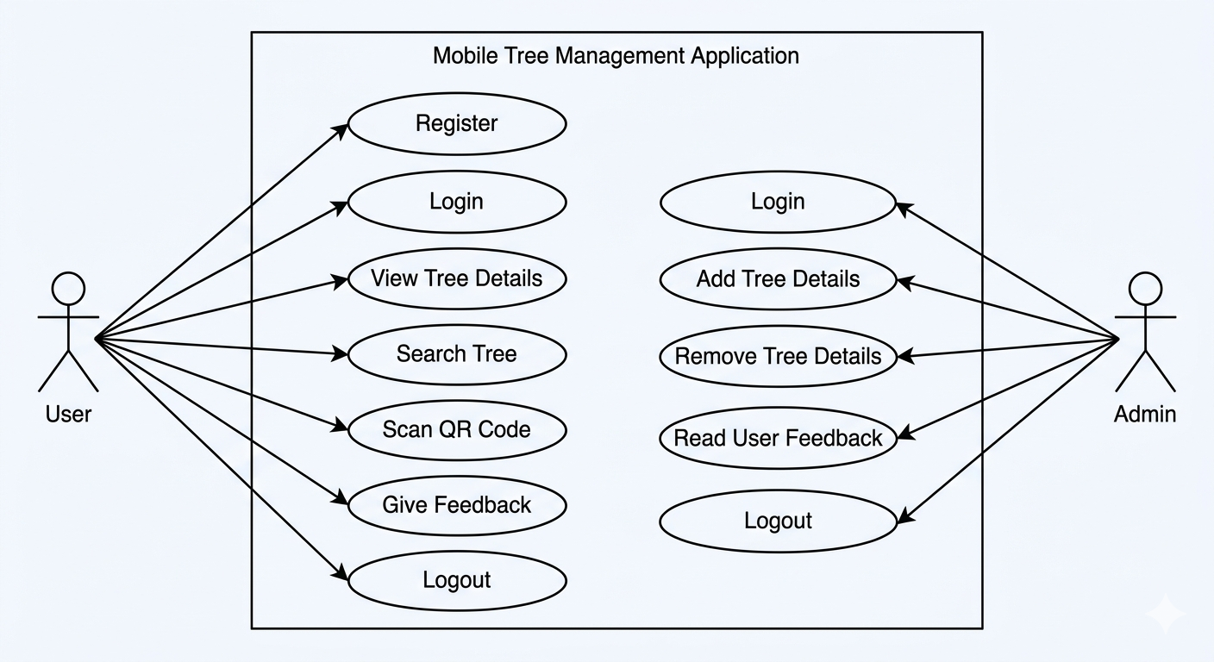
Design – Use Case Diagram
Fig1: Use case diagram for the User and Admin

Slide 15
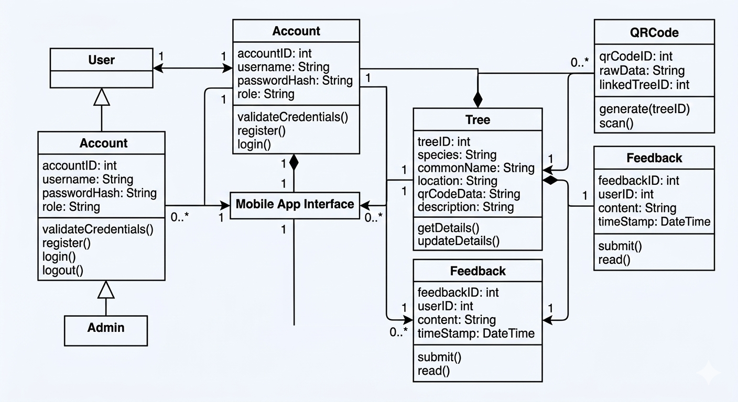
Design – Class Diagram
Fig 2:System Overview

Slide 16
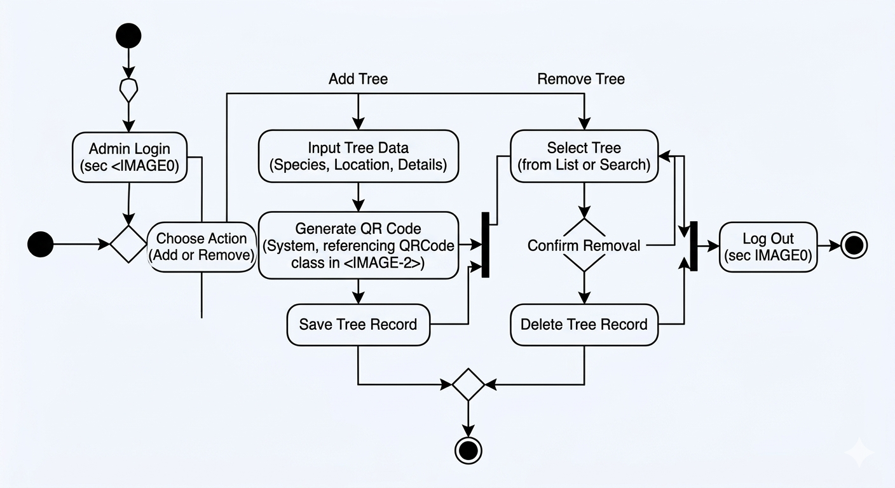
Design – Activity Diagram
Fig 3: Activity Diagram for Tree Management (Admin)

Slide 17
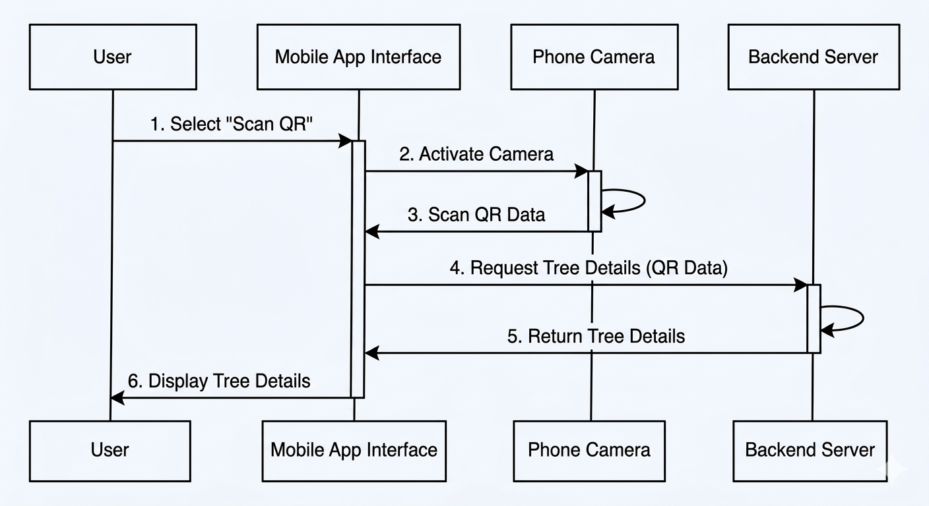
Design – Sequence Diagram
Fig 4: Sequence Diagram focusing on the "Scan QR Code

Slide 18
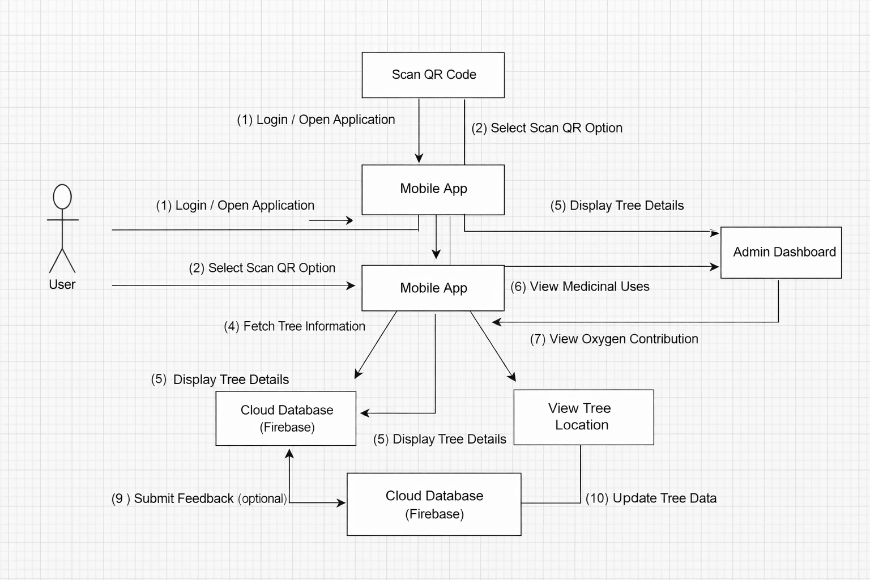
Design – Collaboration Diagram
Fig 5: GreenQR System Collaboration Diagram

Slide 19
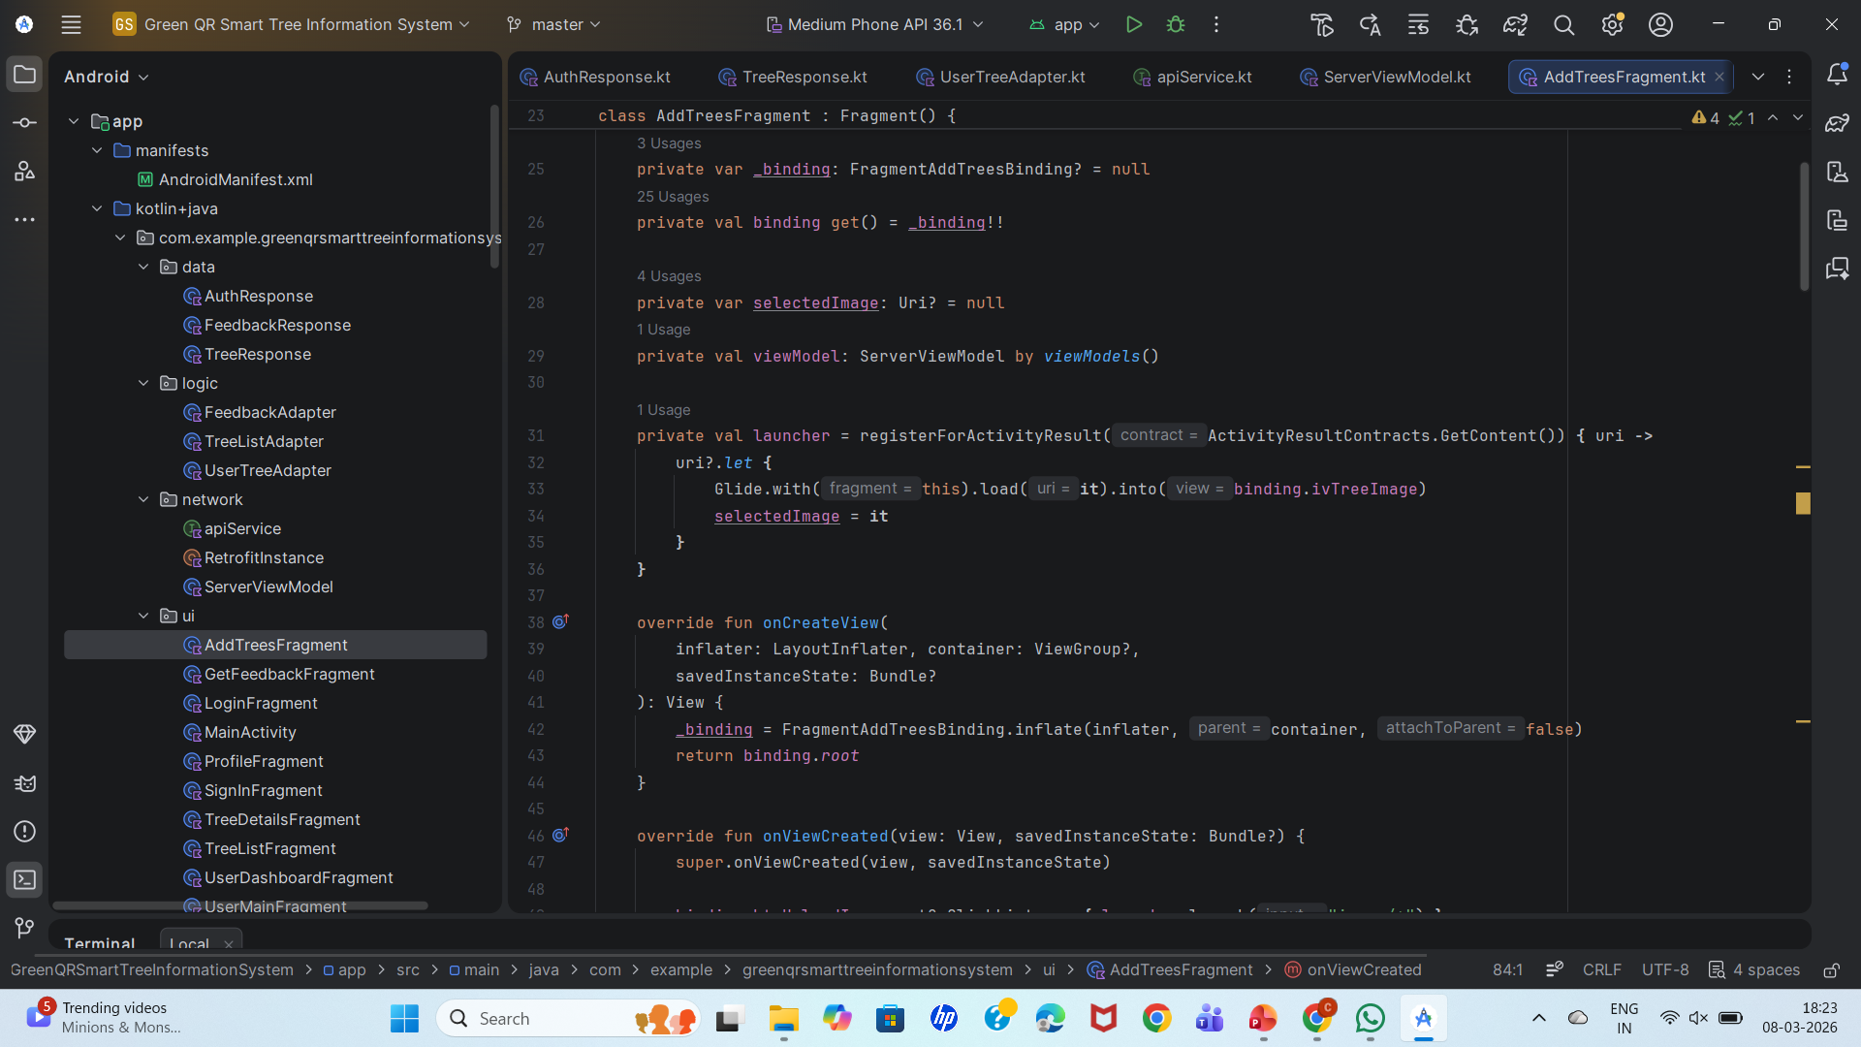
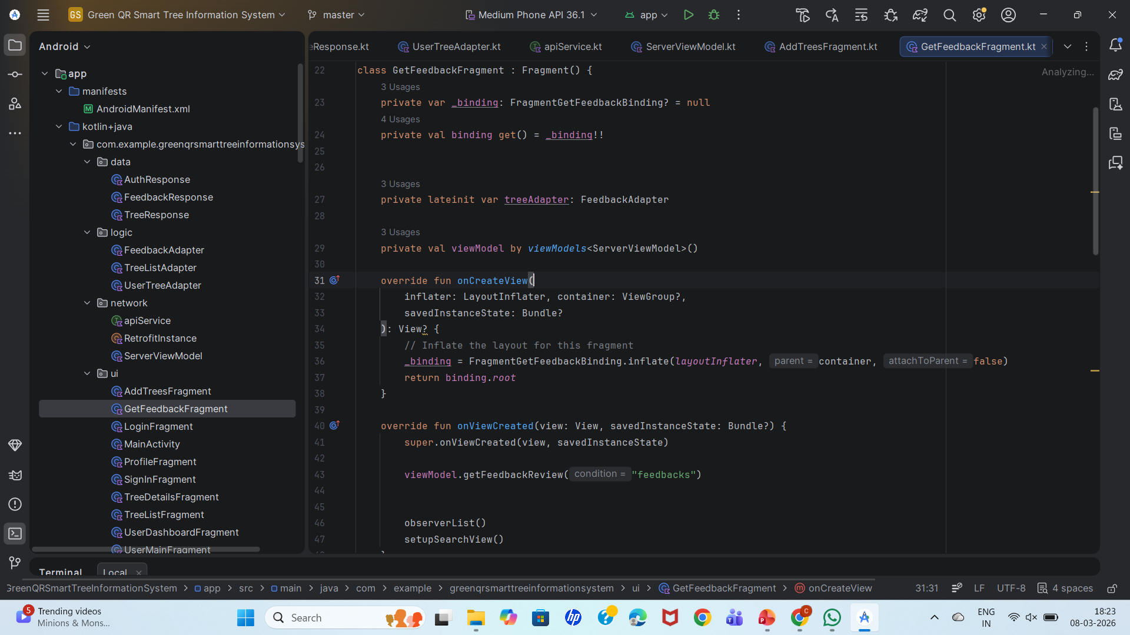
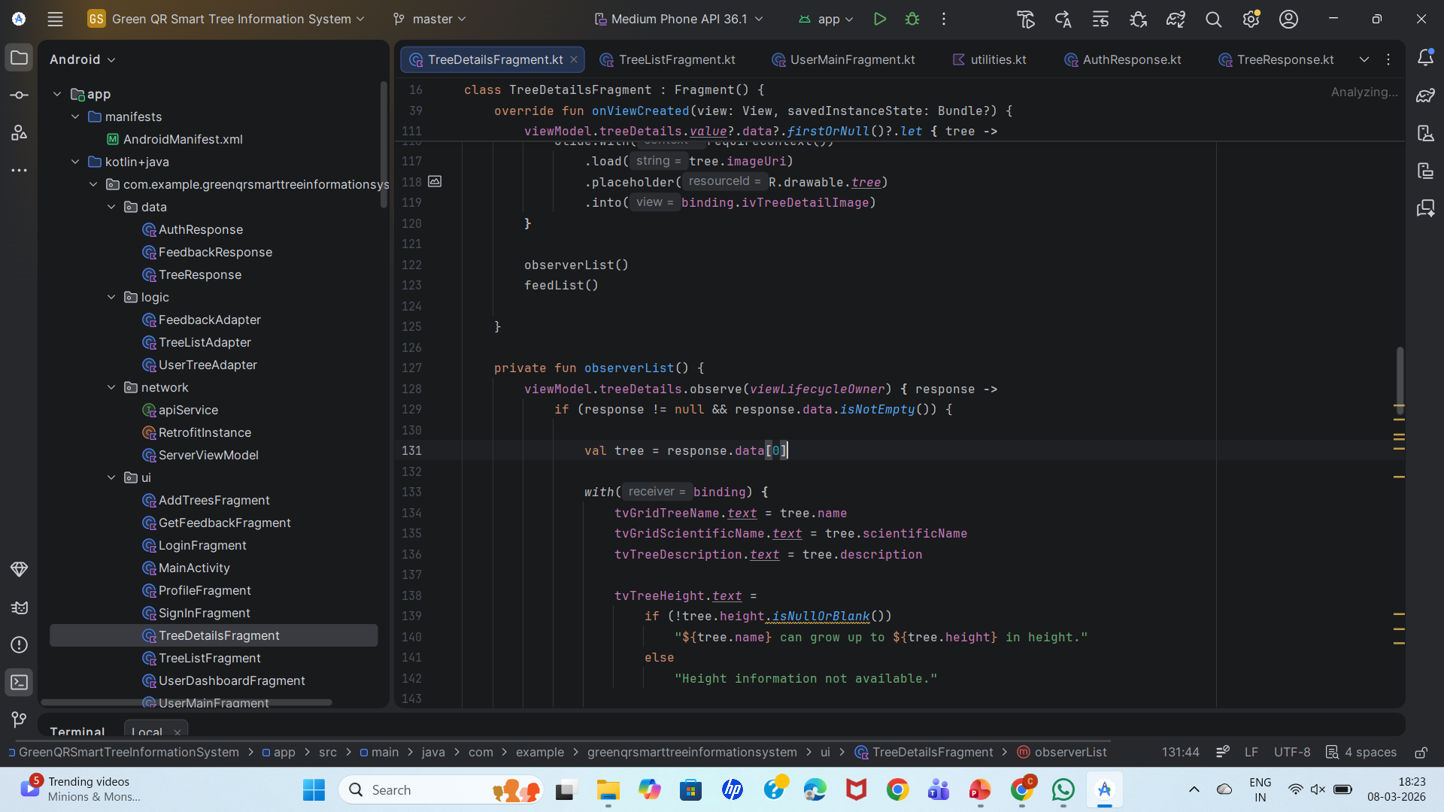
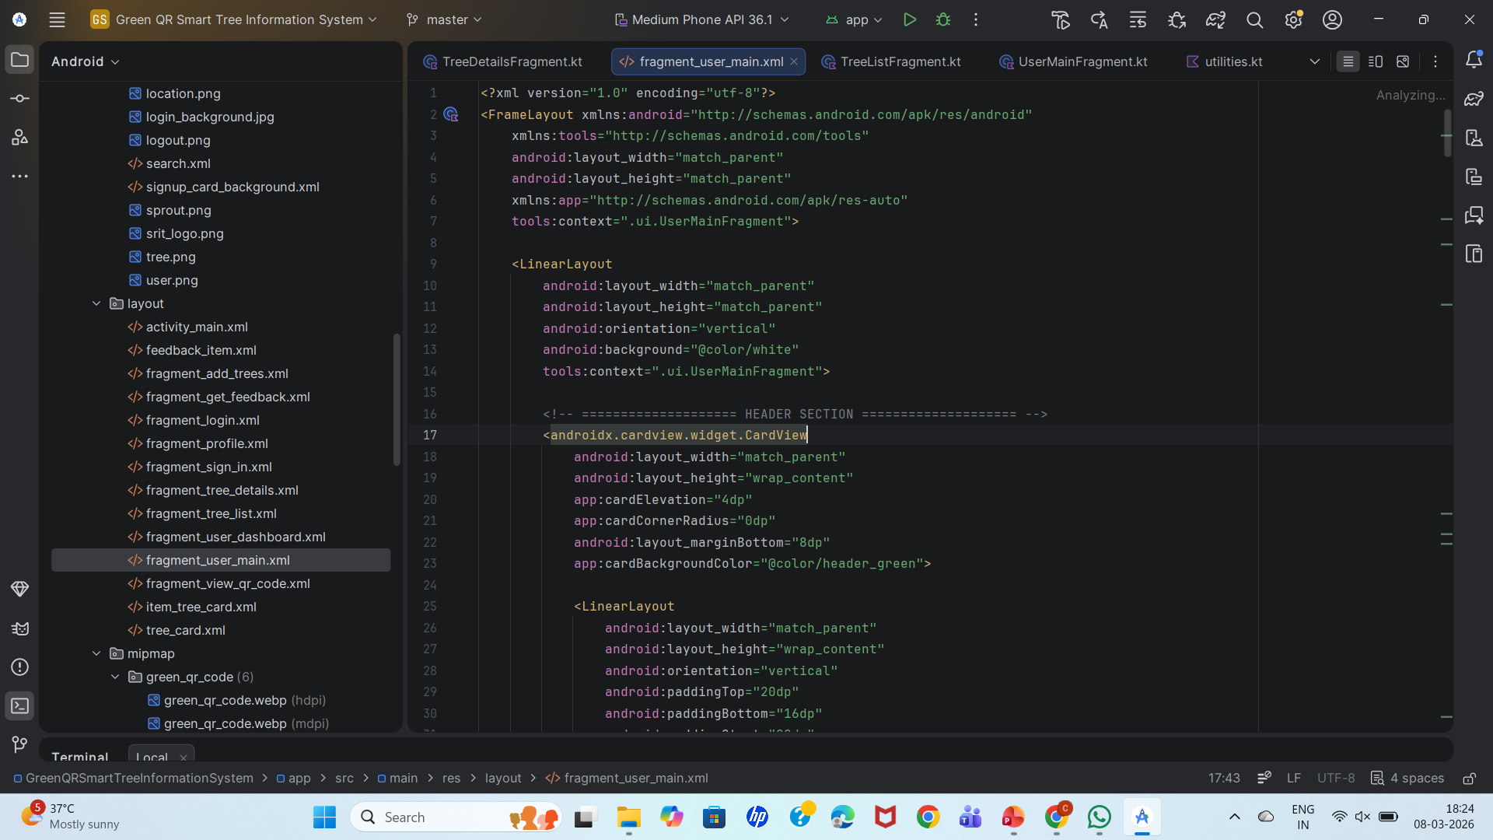
Implementation

Slide 20
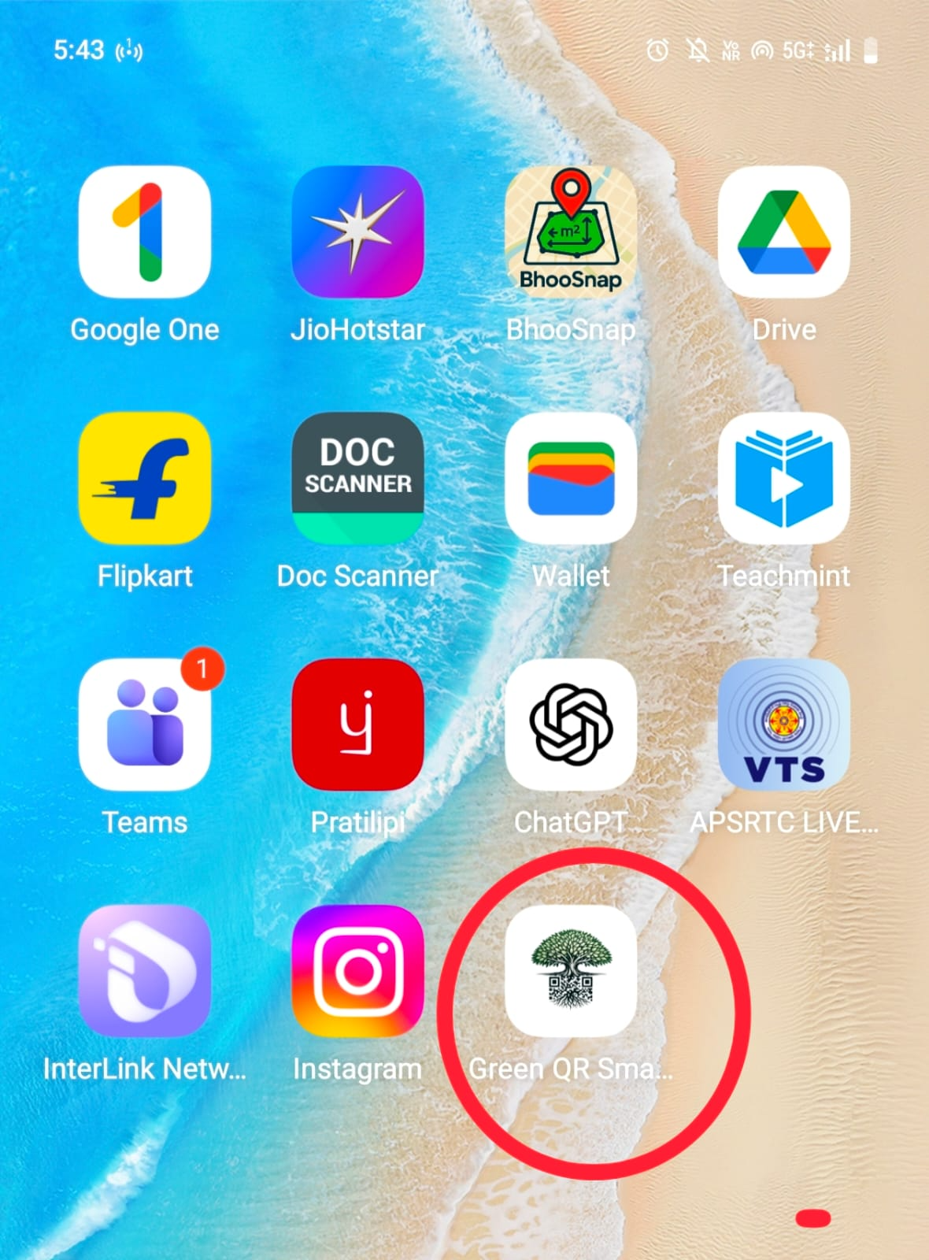
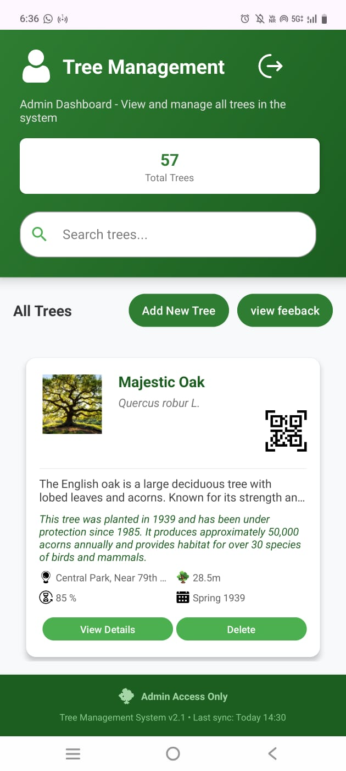
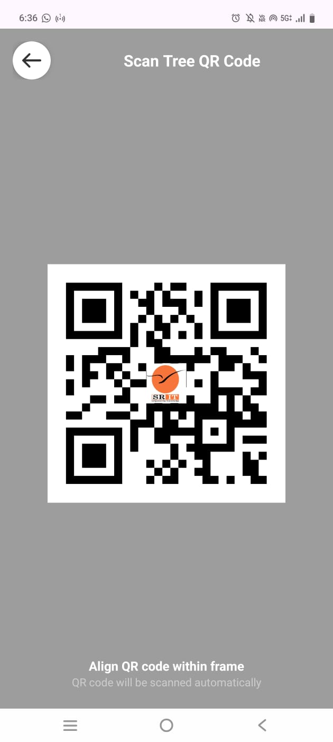
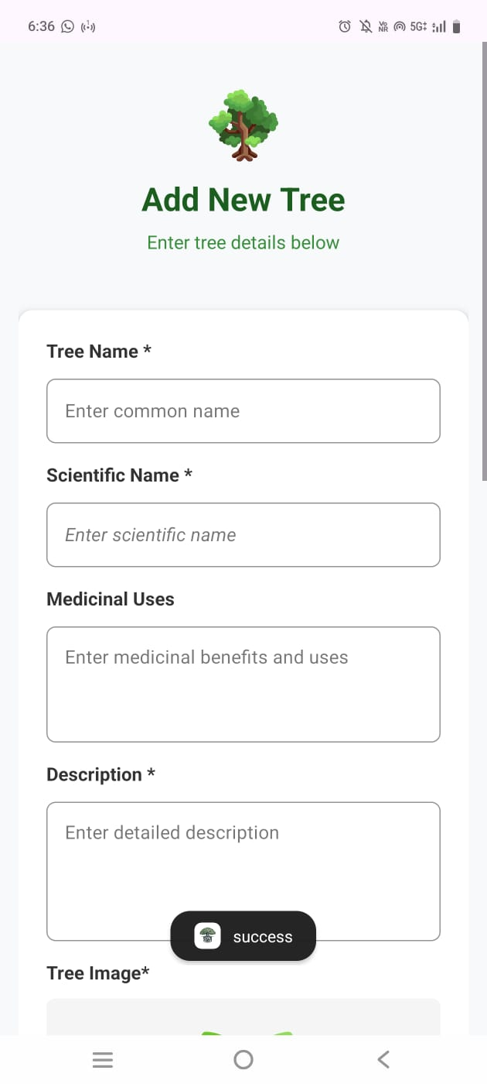
Outputs
App Icon
Admin Dashboard
Scanner
Adding Tree details

Slide 21
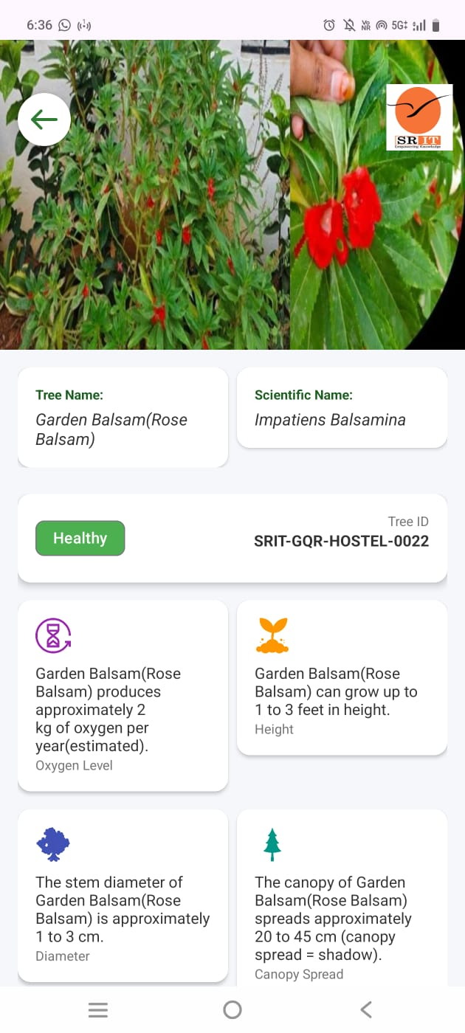
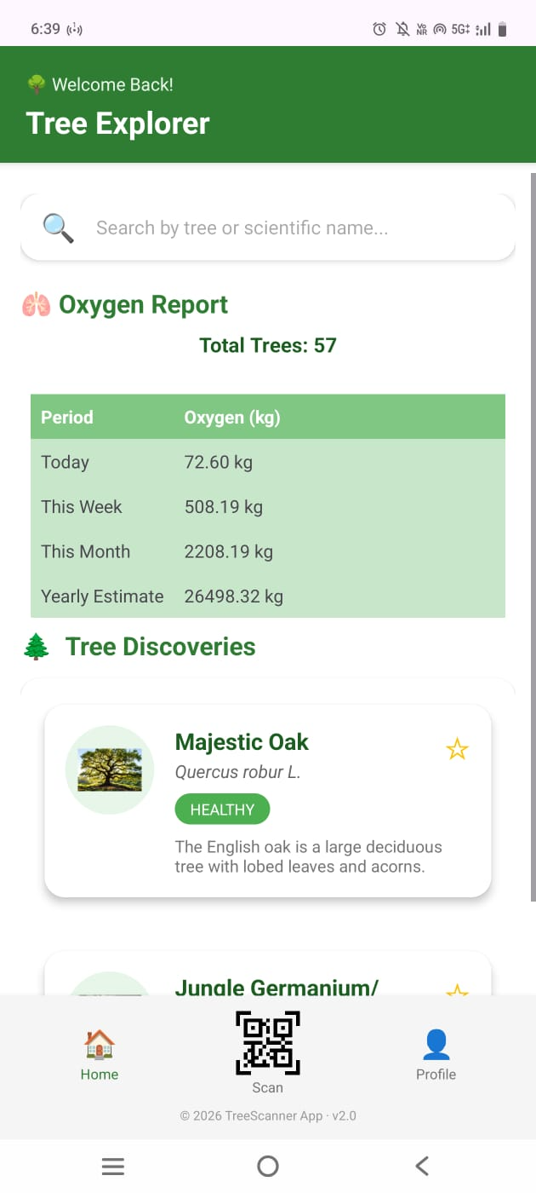
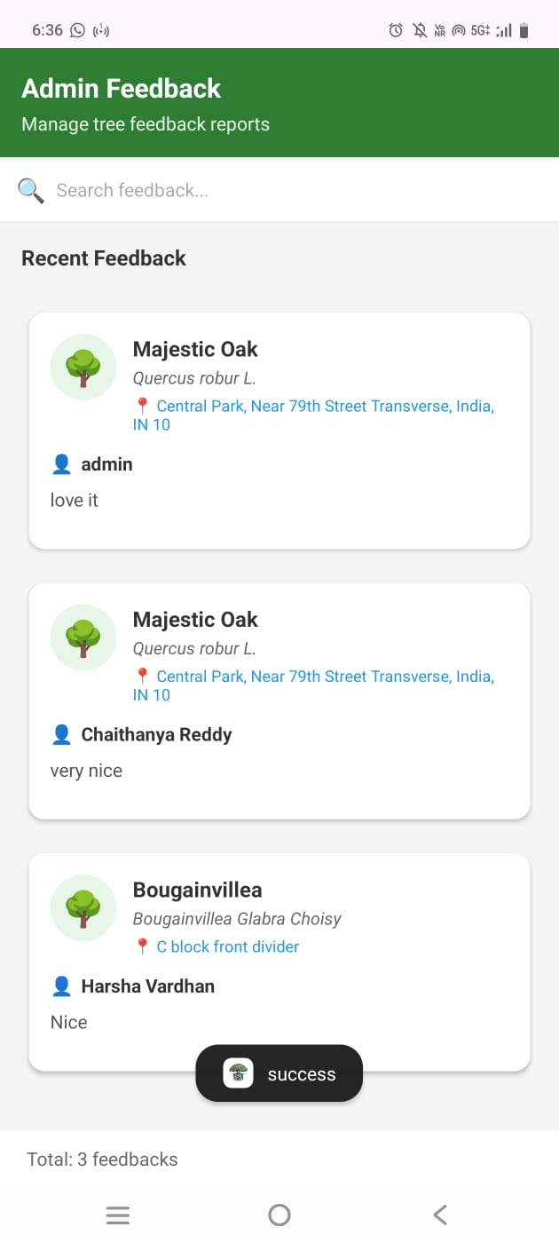
Outputs cont…
Showing Tree deatils
User Dashboard
Feedback

Slide 22
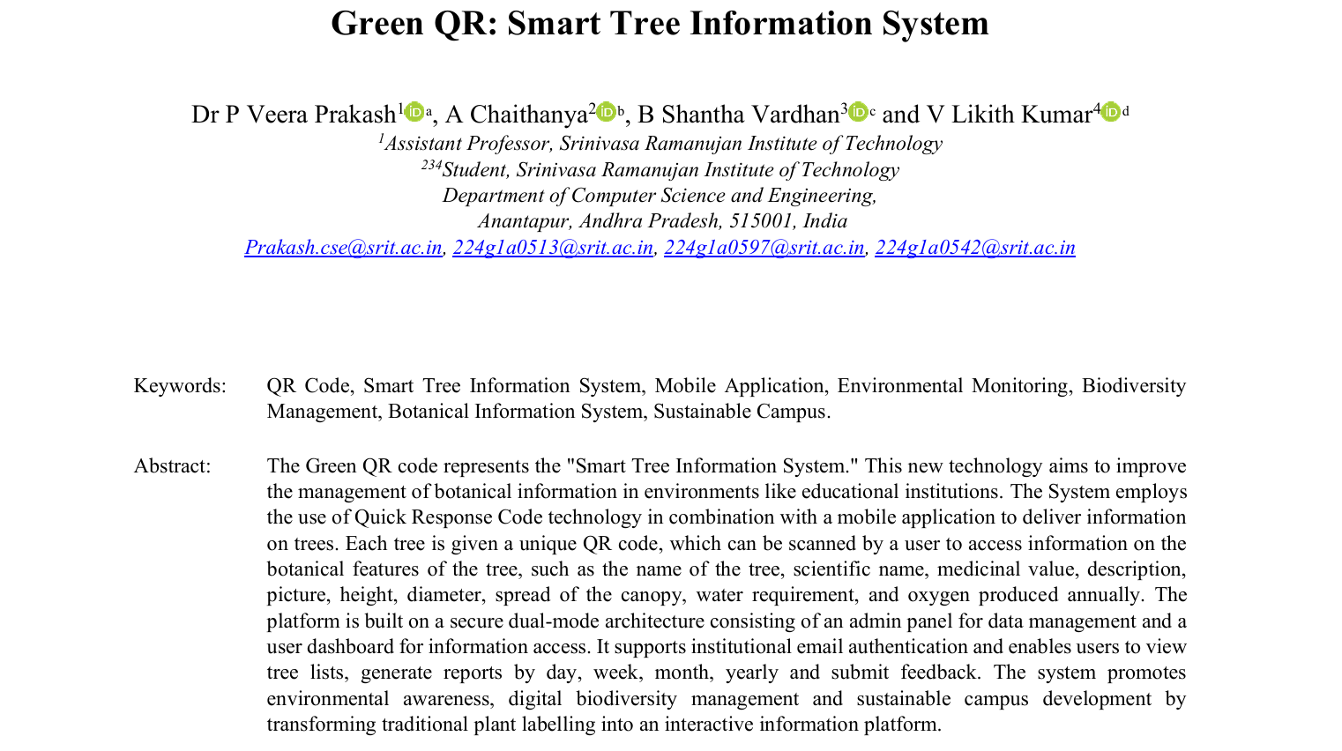
Research Paper
Green QR: Smart Tree Information System
Srinivasa Ramanujan Institute of Technology

Slide 23
References
Green QR: Smart Tree Information System
Syaikhu, A., Soeryaprawira, R. M. L., Daswara, Y. A., & Sarungu, C. M. Analysis and Design of QR Code-Based Information System on Plant Identification. International Journal of New Media Technology, 2023.
Rani, K., Agrawal, M., Mahla, A., Nagar, K., & Sehrawat, A. Interactive Digital Botanical Keys: A Scalable QR Code-Based Platform for Plant Identification.International Journal of Environmental Sciences, 2025.
Suntornmeth, P., Pisjan, P., & Bualek, W. Information Retrieval System of the Tree by Using QR Code Technology. RMUTL Journal of Business Administration and Liberal Arts, 2017.
IRJAEM Journal. Digitalising Green: QR Code-Based Plant Accessing System for Awareness and Conservation. International Research Journal on Advanced Engineering and Management, 2025.
Naga Jyothi, R., Muruga Lakshmi Kumari, R., & Jyothi Mani, V.G. Identification of Trees Using QR Code in College Campus. International Journal of Engineering Technology and Management Sciences, 2023.
Srinivasa Ramanujan Institute of Technology

Slide 24
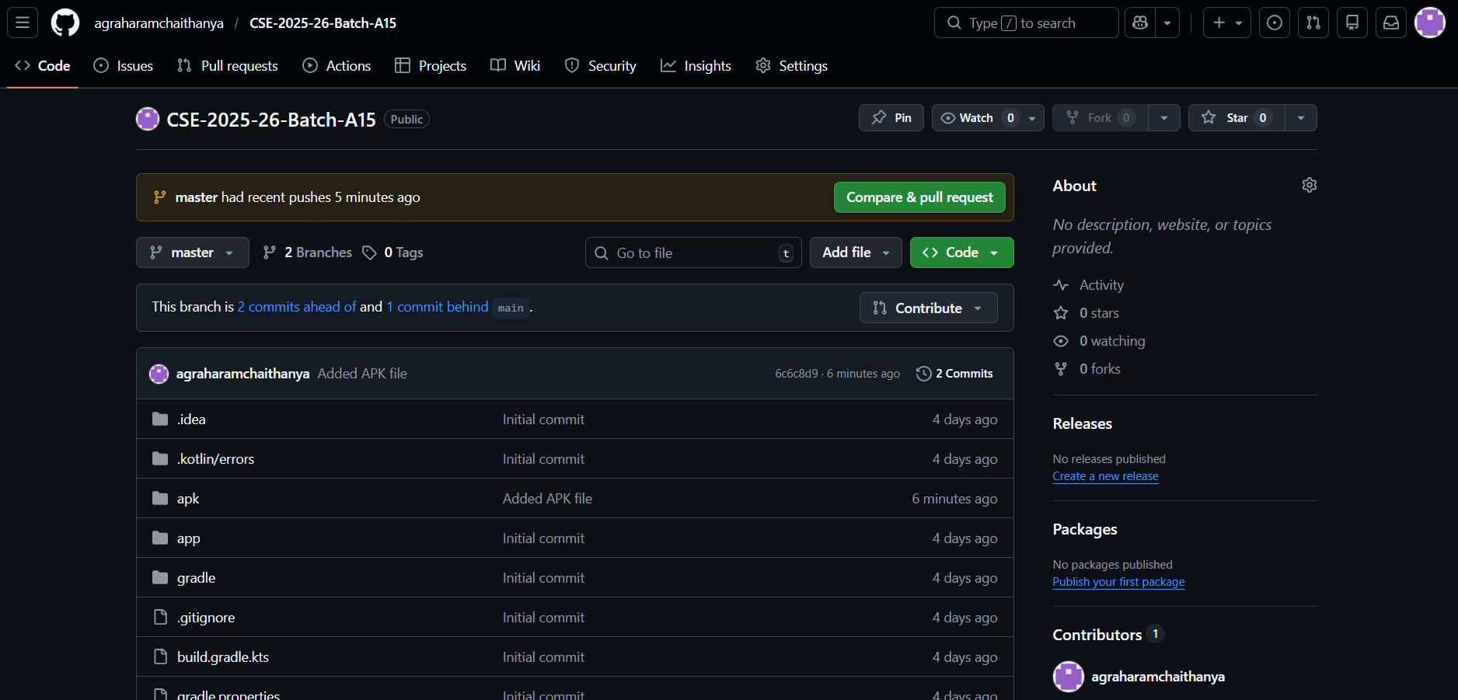
Github Dashboards of each student
Green QR: Smart Tree Information System
https://github.com/agraharamchaithanya/CSE-2025-26-Batch-A15/
https://github.com/LikithKumar2003/
Srinivasa Ramanujan Institute of Technology

Slide 25
Green QR: Smart Tree Information System
Thank You
Srinivasa Ramanujan Institute of Technology

Slide 26
Green QR: Smart Tree Information System
Any Queries
Srinivasa Ramanujan Institute of Technology

